Slide 1
Planning Quantum Stack les 5
Minor Quantum Computing
Ed Kuijpers, e.a.kuijpers@hva.nl
31-5-2024

Slide 2
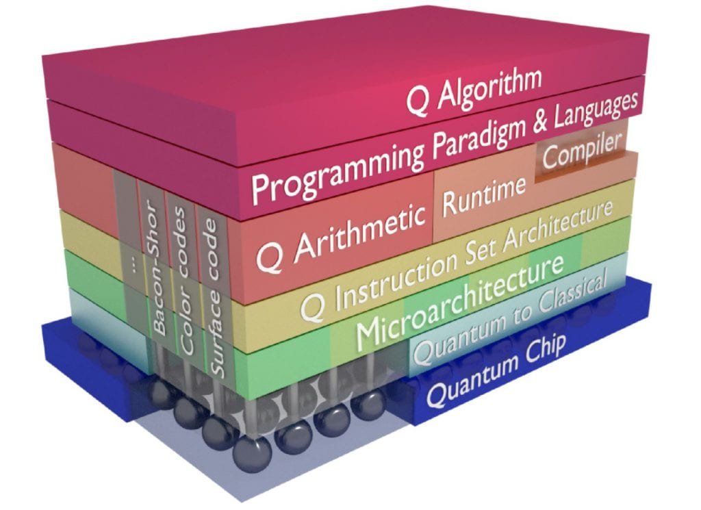
Topics
Structure lessons
Writing paper and presentation in phases
Structure quantum stack
Discussion topics for paper

Slide 3
Quantum Stack
Abstraction layers
Stack models

Slide 4
Structure lessons
Each lesson presentation wil focus on a layer in Quantum Stack
Students individually select Quantum stack topic for writing paper
Students select, motivate and present a topic
Students present draft paper/progress
Finalize paper with final presentation

Slide 5
Draft schedule update
Lesson 1: (19 April): introduction topics
Lesson 2: (26 April)Quantum computing Languages + student paper proposals
Lesson 3: (17 May) Hardware and background + student paper proposals
Lesson 4: (24 May) Quantum hardware, sensing, theory + proposals
Lesson 5 (31 May): Quantum information + progress reporting paper students
Lesson 6 (7 June):Quantum internet + background + progress reporting paper
Lesson 7 (14 June): Quantum stack background + progress reporting+
Lesson 8 (18 June): Paper presentation
Week B5 (Aug): Resit Presentation

Slide 6
Approach
Assignment-1 proposed content paper
Title
Research questions
Motivation
Literature reference(s)
Assignment-2 intermediate results
Draft paper material
Presentation intermediate results
Intermediate feedback via paper and presentations
Assignment-3 upload final paper
Final presentation
Grading

Slide 7
Background
Previous experience for the Software for Science minor (before Quantum Computing)
Number of pages (in English): effort in accordance with Credits (3 ECTS) and quality (7 – 12 pages) including some good figures
https://studiegids.hva.nl/co/hbo-ict-vt/100000042/100888)
In assessment: mix of software experiments with documentation appreciated
Scientific format paper (LaTeX), backup pdf after MSWord conversion
Diversity in topics to avoid too much overlap, interesting,
Avoid grading work twice, i.e. team project result assessment and paper assessment not overlapping
Topics lessons will be adapted to research questions as far as possible (lesson will not limited to one layer)
New Qubit material (Graphene, gold based, superconduction at higher temperatures)

Slide 8
Paper proposals presented en in DLO
Optical computing (Daniel)
Advanced Quantum error correction (recent developments at Microsoft and IBM)(Luca)
OpenQL (Gaurav)
Theoretical design of a QPU(Lilith)
ML en quantum stack for real life cases(Thomas)
OpenQasm(Tijs)
Qubit interaction and physics/electronics? (Ilnur)(ok)
Sensing(Benjamin)(upload?)
The Hybrid Computer: A Classical and Quantum Stack Combined(Qing)

Slide 9
Paper proposals presented en in DLO
Quantum Processor network for variational quantum eigensolver(Siar)
Quantum training acceleration for AI Processes (Jaden)
Quantum and healthcare (Amira)
Transpiling (Bas)

Slide 10
To be presented
Quantun Random Number Generation (QRNG) (Quincy)
Comparison of Qubits (Sebastiaan)
Comparison of quantum technology(Remy)
Quantum memory(Nikolai)
Quantum multiplication(Bjorn)
Marvin
Danny
Bjorn
Joy
Lyra
Ryan

Slide 11
Supporting slides for assignments

Slide 12

Quantum Meets '24
Quantum Meets '24 (swapcard.com), Home | Quantum Delta NL (quantummeets.com)

Slide 13
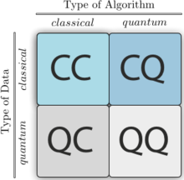
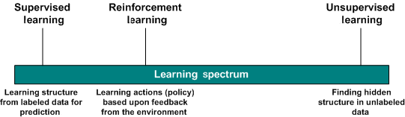
Type of machine learning algorithms

Slide 14
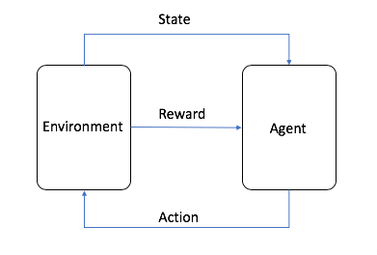
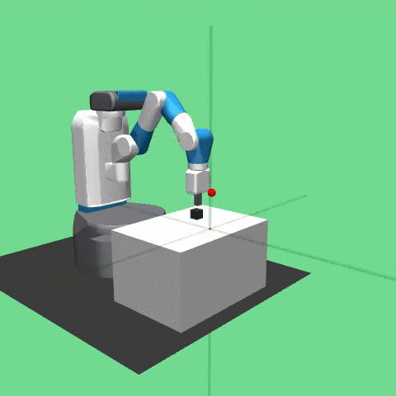
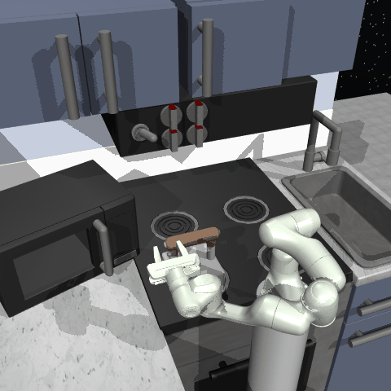
Model reinforcement learning
Gymnasium-Robotics Documentation (farama.org)

Slide 15
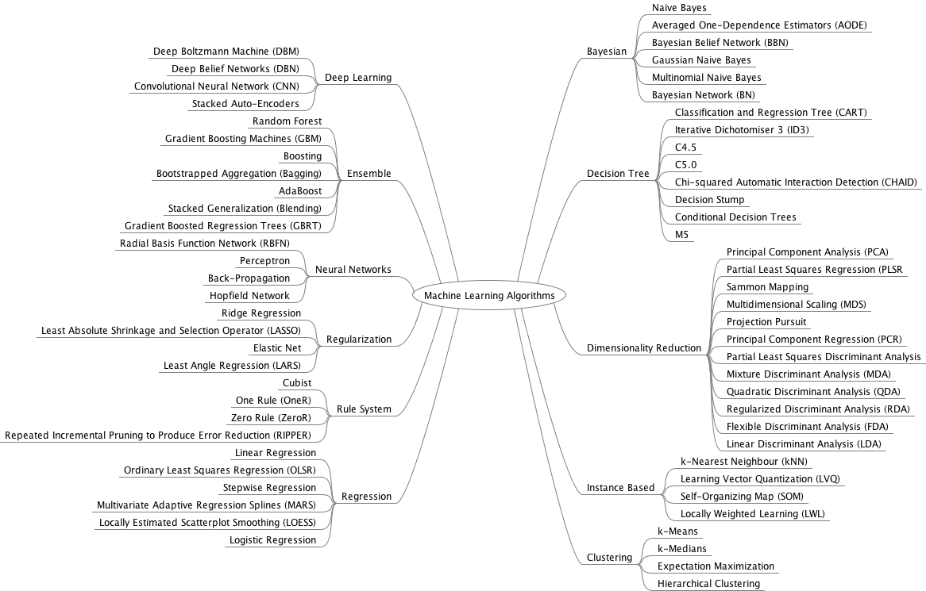
Machine Learning Classical

Slide 16
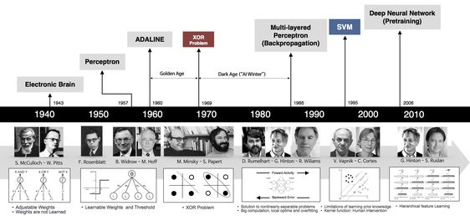
History Neural networks

Slide 17
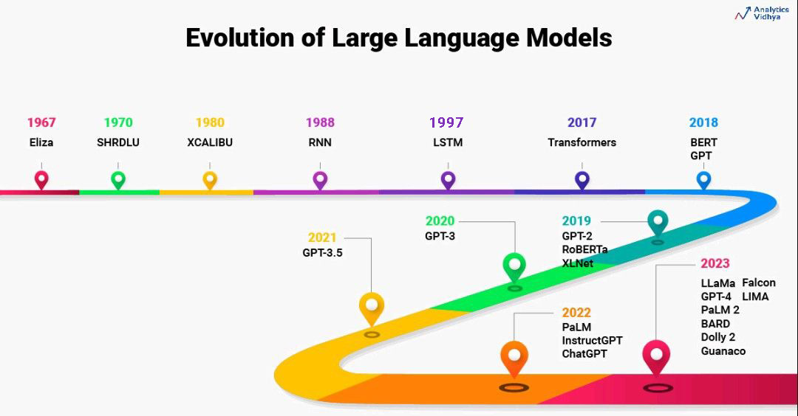

Slide 18
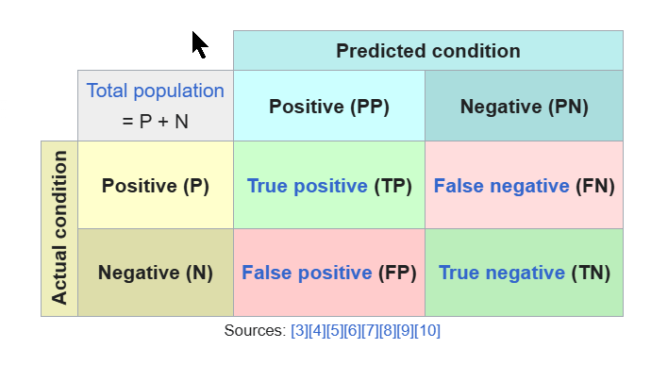
Confusion Matrix
Confusion matrix – Wikipedia
Reality more complicated

Slide 19
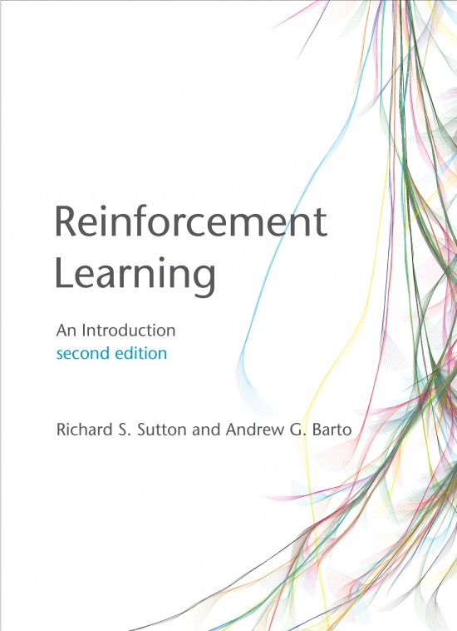
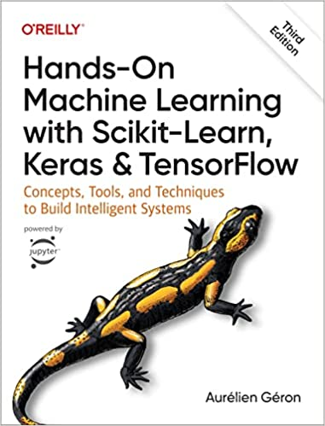
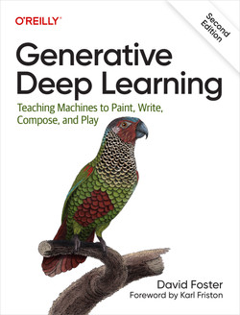
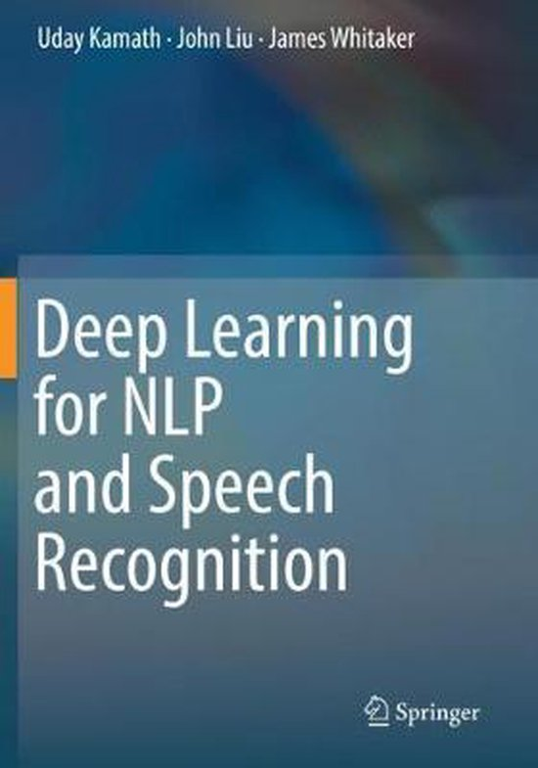
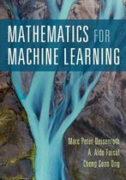
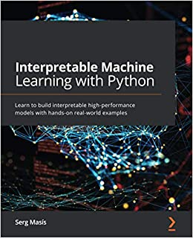
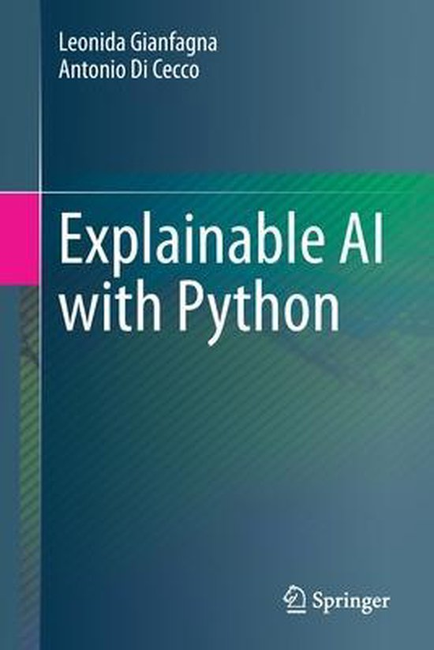
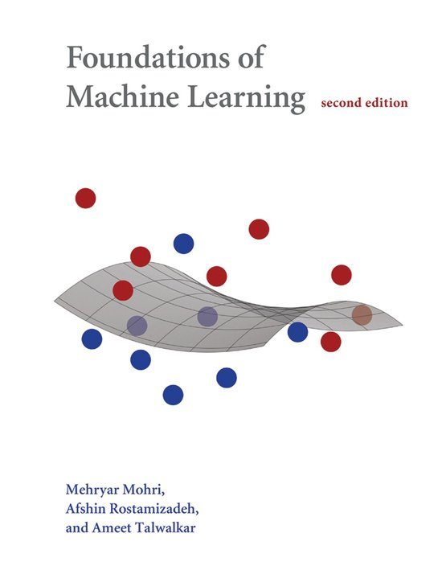
Literatuur
Zie ook:
https://databanken.bibliotheek.hva.nl/
(flinke investering HvA en maak er gebruik van)

Slide 20
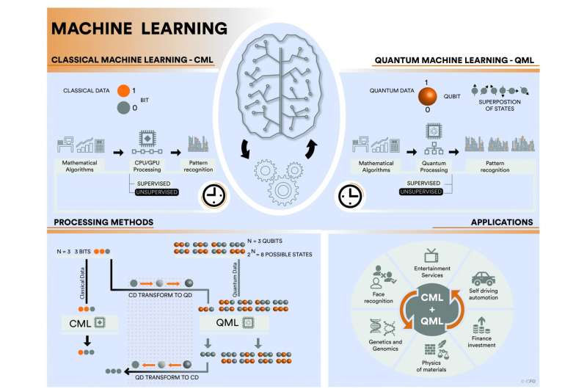

Slide 21
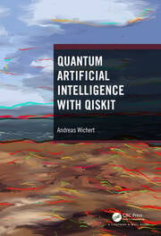
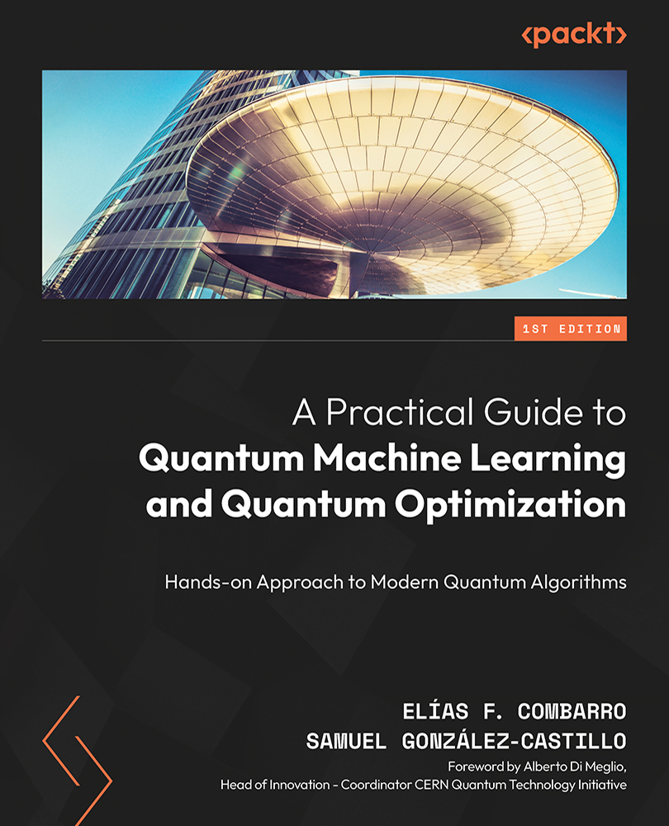
Quantum Machine Learning Books
Chapter 18 on QRAM with notebook:
https://github.com/andrzejwichert/qai
https://github.com/andrzejwichert/qai.git
https://github.com/PacktPublishing/A-Practical-Guide-to-Quantum-Machine-Learning-and-Quantum-Optimization.git

Slide 22
References
2402.14694 (arxiv.org): A Quick Introduction to Quantum Machine Learning
for Non-Practitioners
qiskit-machine-learning · PyPI
https://www.tensorflow.org/quantum
https://pennylane.ai/
https://qiskit-community.github.io/qiskit-machine-learning/
and much more

